Slide 1


Customer Satisfaction Survey
Improve customer satisfaction with actionable data

Slide 2

Not getting quality customer feedback?
BUSINESS CONCEPT

Slide 3


Start asking the right questions to your
customers at the right time
Make conversations, let them know their opinions matter!!!

Slide 4

Ask customers for feedback in the right channel
Forget the paper, emails or snail mails, do surveys the right way, using mobile apps online or offline
BUSINESS CONCEPT

Slide 5
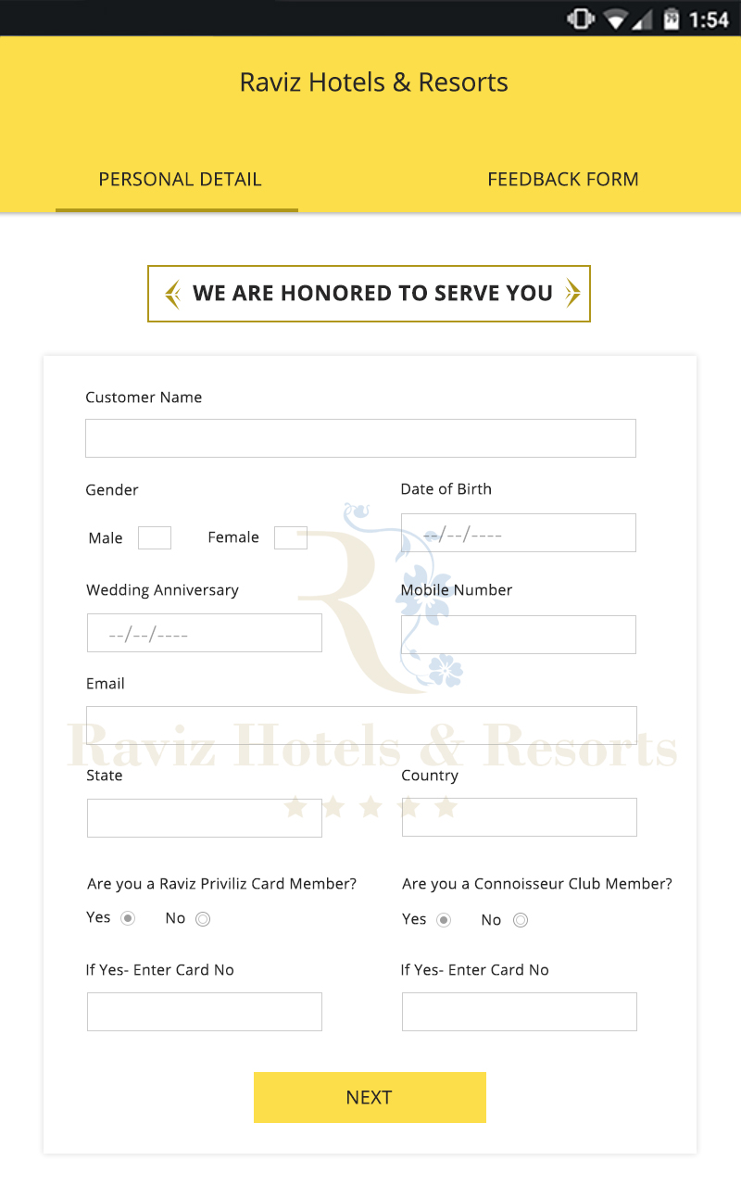
Ask for feedback based on customer behavior
Create customized surveys that are relevant, depending on seasons, holidays or business opportunities. Capture customer experience while its still fresh in their mind
BUSINESS CONCEPT

Slide 6
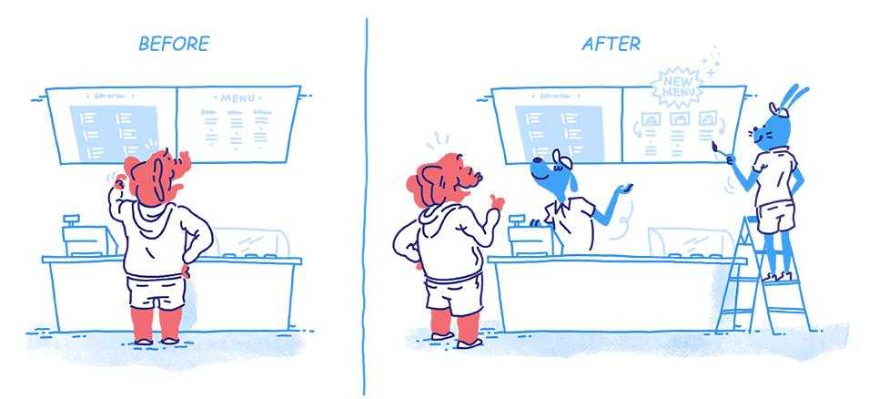
Make better decisions based on quality feedback
Stop guessing what your customers want.
Use feedback from conversations to drive your decisions.
BUSINESS CONCEPT

Slide 7
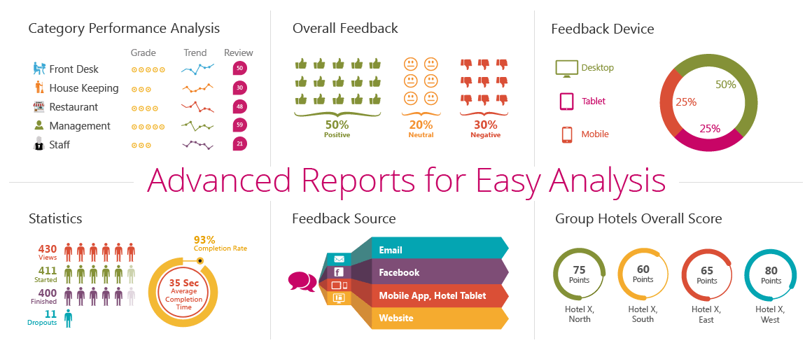
Track results and get insight
BUSINESS CONCEPT
Create custom reports and dashboards based on requirement.*
(* Actual images/graphs may vary)

Slide 8
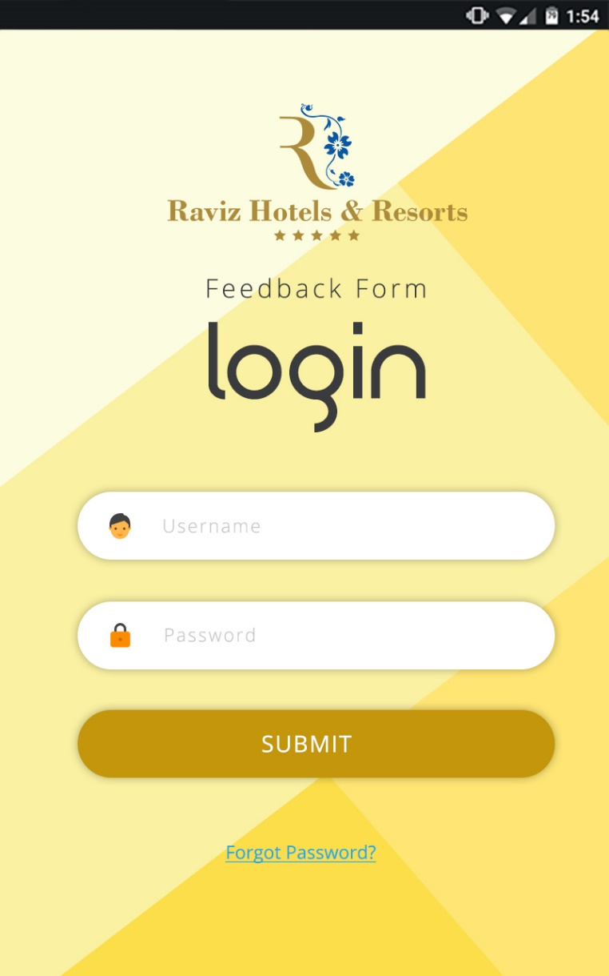
Application features
Set As Kiosk or Hand It Over
Set up your tablet as kiosk for non-assisted mode or take feedbacks in person
Capture Feedback Without WiFi
No WiFi? No problem! Take offline tablet feedbacks. Sync data anytime.
Designed for Non-Techies
The App is super easy to setup & use. Designed for non-techies for hassle-free use.
Sync Securely
All data is maintained & synced to a secure, centralized cloud server
Android App
Set up surveys on any Android tablets – The App works consistently across all devices
One App Mode
Switch on one app mode to enable only the app in the tablet and prevent any tablet misuse
BUSINESS CONCEPT

Slide 9
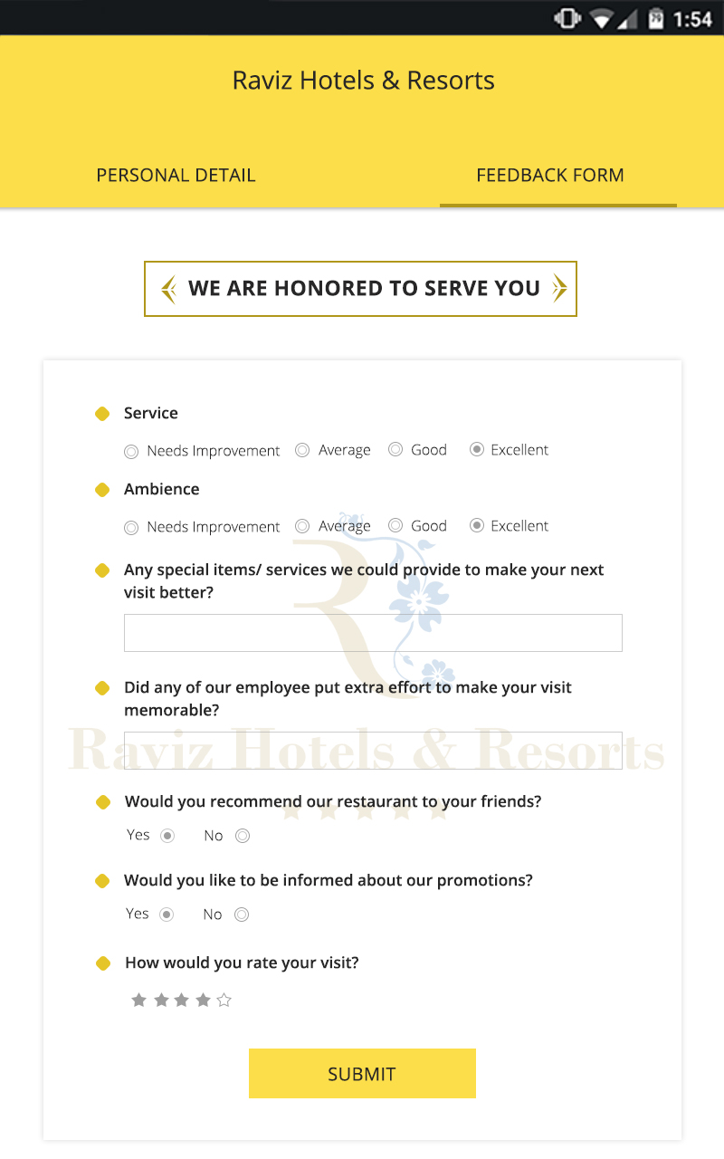
Application features
Integrate the app with internal applications
Create custom surveys
Permission based user management
Dashboard that conveys meaning to customer responses
Multi location application
Real time drill down reports for further analysis
Multi location survey management
BUSINESS CONCEPT

Slide 10

Thank You
www.tollant.com
© 2017. All Rights Reserved. Tollant International Pvt Ltd

